Slide 1
Hypertext Transfer Protocol
Introduction to HTTP | Request and response headers | Request methods and response status codes | Browser caching | HTTPS
Notes:
Welcome to our lecture on HTTP (Hypertext Transfer Protocol), the standard for web communication using TCP/IP for data transfer. HTTP/1.1 is widely used, HTTP/2 enhances speed, and HTTP/3 (in development) uses UDP for faster performance. A DNS lookup converts a domain name into an IP address, enabling server connection. HTTP uses a request-response model where the browser requests resources and the server responds.

Slide 2

Introduction to HTTP
HTTP: Protocol for web communication over TCP/IP.
Versions: HTTP/1.1 (standard), HTTP/2 (faster), HTTP/3 (UDP-based, in development).
DNS Lookup: Resolves domain to IP for server connection.
Request-Response: Browser requests resources; server responds.
Notes:
HTTP (HyperText Transfer Protocol) is the standard for web communication, using TCP/IP to transfer data. HTTP/1.1 is the standard, HTTP/2 improves speed, and HTTP/3 (in development) uses UDP for faster performance. Before communication, a DNS lookup converts a domain name to an IP address, enabling server connection. HTTP follows a request-response model where the browser requests resources and the server responds.

Slide 3
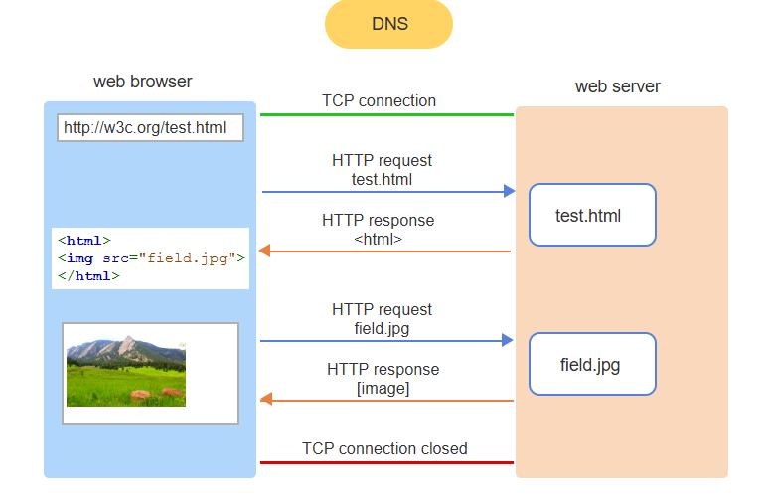
HTTP requests and responses.
The web browser does a DNS lookup of the domain name w3c.org and uses the IP address to create a TCP connection to the web server.
The web browser sends an HTTP request asking for the resource test.html.
The web server returns the contents of test.html to the browser in an HTTP response.
The browser parses the HTML and sends a second HTTP request for field.jpg.
The web server returns the image to the browser in an HTTP response. The browser displays the image on the webpage.
When no more resources are needed, the browser closes the TCP connection.
Notes:
This slide explains how HTTP requests and responses work. The browser performs a DNS lookup to find the server's IP and establishes a TCP connection. It requests test.html, the server responds with the HTML, and the browser parses it. If additional resources like field.jpg are needed, another HTTP request is sent. The server responds with the image, which the browser displays. The TCP connection closes after all resources are received.

Slide 4
Request and response headers
An HTTP request and an HTTP response are both composed of four parts:
Start line: The start line specifies the HTTP version being used. A request's start line includes a request type and path; a response's start line includes a status code and phrase.
Zero or more header fields: A header field is a keyword followed by a colon and a value. Header fields supply additional information about the request or response.
A blank line
Optional message body: A message body contains data being transferred between a web browser and web server. In a request, the message body may be empty or contain submitted form data. In a response, the message body may contain the requested resource.
Notes:
Next, we'll discuss Request and Response Headers, key parts of HTTP communication. Each request and response has four parts: the Start Line shows the HTTP version, method, and status code. Header Fields provide extra details like content type. A Blank Line separates headers from the body. The Message Body (optional) carries data like form inputs or web content. These elements explain how data flows between a browser and server. Next, we'll cover request methods and status codes.

Slide 5
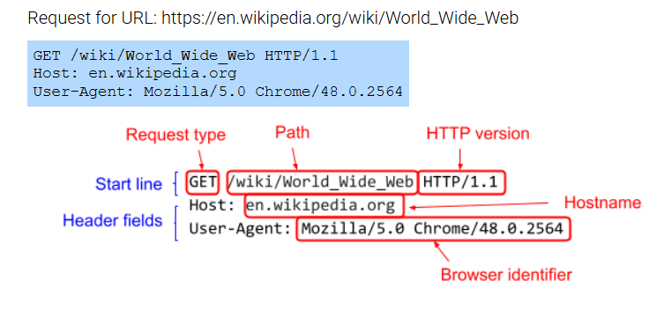
HTTP request with no message body
Notes:
This slide explains an HTTP request with no message body using a GET request for https://en.wikipedia.org/wiki/World_Wide_Web. The Start Line includes GET (requests data), the Path /wiki/World_Wide_Web (resource location), and HTTP/1.1 (protocol version). Header Fields specify the target server (Host: en.wikipedia.org) and browser (User-Agent). Since GET only retrieves data, no message body is included. Next, we'll explore POST requests for data submission.

Slide 6
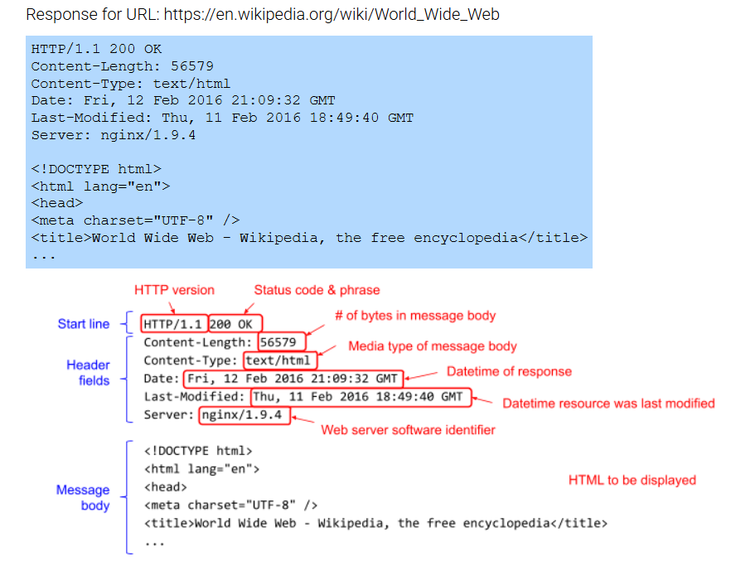
HTTP response with HTML in message body
Notes:
This slide explains an HTTP response with an HTML message body, showing how a server replies to a request. The Start Line (HTTP/1.1 200 OK) indicates a successful request. Header Fields include Content-Length (response size), Content-Type (text/html), Date (response time), Last-Modified (last update), and Server (software used). The Message Body contains the HTML content for rendering. Next, we'll explore HTTP status codes in detail.

Slide 7
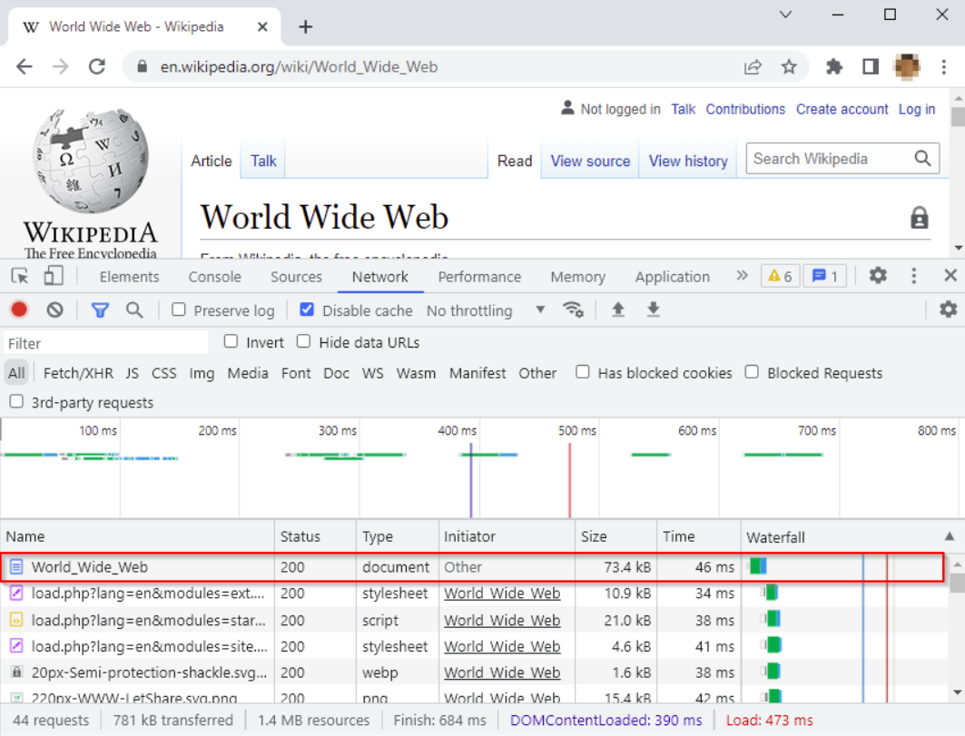
Chrome DevTools for watching HTTP traffic
All popular web browsers have built-in developer tools.
In Chrome,Chrome, access DevTools with Ctrl+Shift+I (Windows) or Command+Option+I (Mac).
The Network tab displays HTTP network traffic when loading a webpage.
The first HTTP request is for the main webpage, while subsequent requests are for additional resources.
Notes:
Now we'll discuss Chrome DevTools, a powerful tool for monitoring HTTP traffic. Most modern browsers have built-in developer tools for inspecting network activity. In Chrome, you can open DevTools using Ctrl+Shift+I (Windows) or Command+Option+I (Mac). The Network tab displays all HTTP traffic when a webpage loads. The first HTTP request fetches the main page, while additional requests load resources like stylesheets, scripts, and images.

Slide 8
Request methods and response status codes
The GET request is the most common HTTP request, where the browser requests a resource, and the server responds with a 200 OK status code.
An HTTP request method specifies the action to perform on a resource.
POST is commonly used for submitting form data to the server.
POST, PATCH, PUT, and DELETE are used in web services to create, modify, and delete resources on the server.
Notes:
Let's explore HTTP request methods and response status codes, essential for web communication. The most common method, GET, requests resources, with a successful response returning a 200 OK status code. Request methods specify actions on resources: POST submits form data, while POST, PATCH, PUT, and DELETE are commonly used in web services for creating, updating, and deleting resources. These methods support dynamic web interactions and data management.

Slide 9
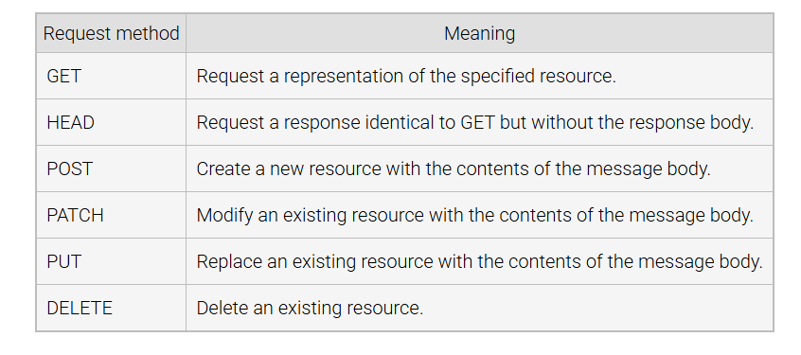
Common HTTP request methods
Notes:
This slide highlights common HTTP request methods that define actions a client performs on a server resource. GET retrieves a resource, often for web pages. HEAD works like GET but only returns headers, useful for checking availability. POST sends data to the server, commonly for forms. PATCH makes partial updates, PUT replaces the entire resource, and DELETE removes a resource. These methods enable efficient data retrieval and modification for dynamic web apps.

Slide 10
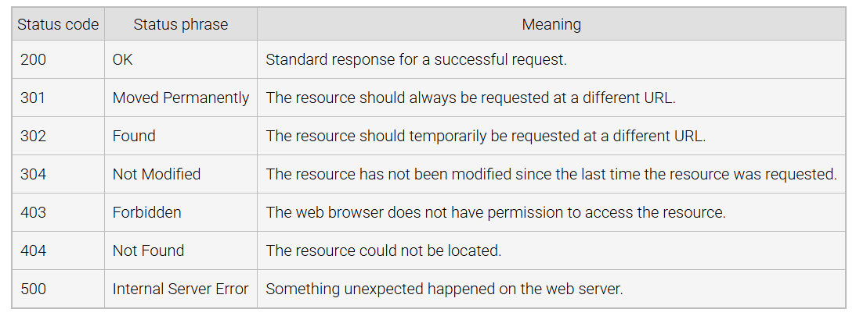
Common HTTP response status codes
Notes:
This slide explains common HTTP response status codes, which indicate request outcomes. 200 OK means success. 301 Moved Permanently and 302 Found indicate resource redirection. 304 Not Modified means no changes since the last request. 403 Forbidden denies access, while 404 Not Found indicates a missing resource. 500 Internal Server Error signals a server issue. These codes help browsers and developers understand results and troubleshoot effectively.

Slide 11
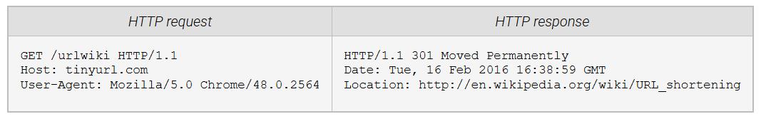
URL shortening
Notes:
Now, I'll explain URL shortening and how it works with HTTP. When a browser makes a GET request to a shortened URL like tinyurl.com/urlwiki, the server processes it and responds with a 301 Moved Permanently status code, indicating a permanent redirection. The Location header points to the full URL (http://en.wikipedia.org/wiki/URL_shortening). URL shortening simplifies long links, making them easier to share while still redirecting users to the original destination.

Slide 12
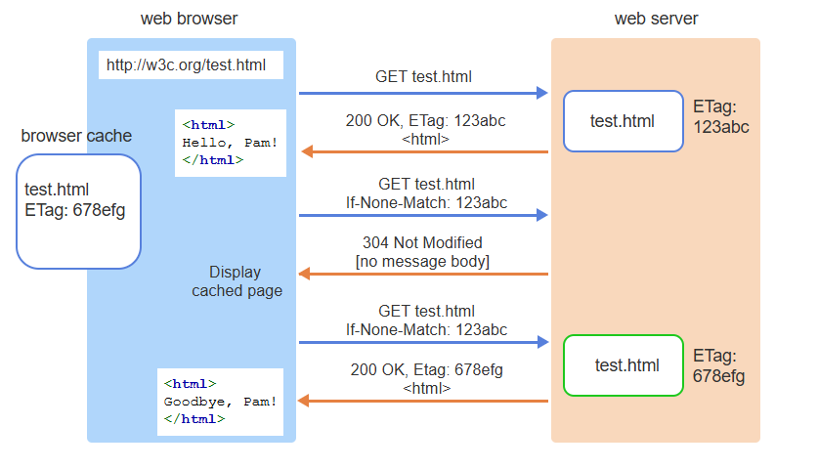
A browser cache is an area on the computer's file system where web content can be stored by the web browser for quick retrieval later
An entity tag (ETag) is an identifier for a specific version of a web resource.
The browser requests uncached resource test.html. The web server returns the contents of test.html back to the browser where test.html is cached.
The second request for cached test.html includes the ETag 123abc.
The web server compares ETags and notes the file has not changed, so 304 is returned with no HTML. The browser displays the cached content.
test.html is modified on the web server and assigned a new ETag.
The browser sends a third request for test.html with ETag 123abc.
The web server compares ETags and notes the file has changed, so 200 is returned with new HTML and ETag.
The browser displays the new content and updates the browser cache.
Browser Cahcing
Notes:
Let's discuss browser caching, where web content is stored locally for faster loading and reduced bandwidth use. An Entity Tag (ETag), a unique identifier for a resource version, helps track content changes. On the first request, the server sends the resource with an ETag, which the browser caches. On repeat requests, the browser checks the ETag. If unchanged, the server responds with 304 Not Modified; if modified, it sends 200 OK with the updated resource and a new ETag.

Slide 13
Other caching mechanisms
If-Modified-Since is used with the Last-Modified date/time to request the web server only send the requested resource if the resource has changed since the specified date/time. Ex: "If Modified Since: Wed, 01 Sep 2019 13:24:52 GMT" asks the web server to send the resource if the resource was modified after Sep 1, 2019 at 13:24:52 GMT.
Expires contains a date/time indicating when the requested resource is considered "stale". Ex: "Expires: Wed, 01 Sep 2019 13:24:52 GMT" tells the web browser to show the cached resource until Sep 1, 2019 at 13:24:52 GMT.
Cache-Control is used to specify a number of caching directives. Ex: "Cache-Control: no-store" tells the web browser to never cache the requested resource, and "Cache-Control: max-age=180" tells the browser to cache the resource for 180 seconds.
Notes:
This slide covers caching mechanisms for managing web content storage and updates. If-Modified-Since ensures the server sends a resource only if it has changed since a specified date, reducing unnecessary data transfer. Expires sets when cached content becomes stale, while Cache-Control defines rules like "no-store" to prevent caching or "max-age=180" to cache content for 180 seconds. These mechanisms balance freshness and efficiency, improving web performance.

Slide 14
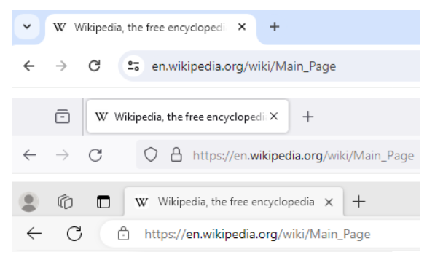
Network Sniffer: Software that monitors network traffic, allowing inspection of HTTP requests and responses.
HTTPS Encryption: Encrypts HTTP traffic to prevent third parties from intercepting sensitive data like passwords and credit card details.
TLS (Transport Layer Security): A protocol using asymmetric encryption with public and private keys for secure data transfer.
Digital Certificate: Websites using HTTPS must obtain a certificate from a trusted certificate authority to validate their identity and enable secure encryption.
HTTPS
Notes:
Finally, we'll explore HTTPS and how it secures web traffic. A Network Sniffer can monitor network traffic and inspect unencrypted HTTP data. HTTPS encryption prevents this by encrypting data exchanged between a browser and server, protecting sensitive information like passwords and credit card details. TLS (Transport Layer Security) uses asymmetric encryption with public and private keys. Websites need a Digital Certificate from a trusted authority to ensure secure encryption and validate identity.

